Slide 1
Dear Year 3,
________________________________________________________________________________________________________________________________________________
Yours Fondly
_________________
Year 3
C/- Saint Stephens College
Reserve Rd
Coomera, Qld 4210

Slide 2
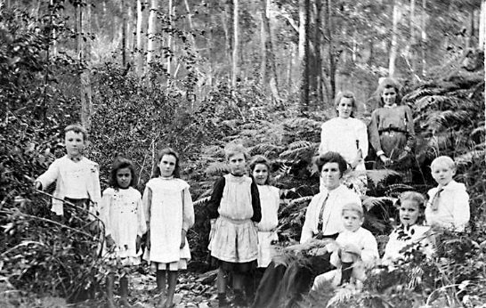

Slide 3
Lesson 11- Postcard from the Past Imagine you are a student going to school in the past. Write a postcard to a year 3 class of the future explaining what your day at school was like.
Remember to introduce yourself, include your journey to school, what is happening at school, how you are dressed, what your teacher is like, what difficulties did you encounter today and any other interesting facts about your school.

